Slide 1
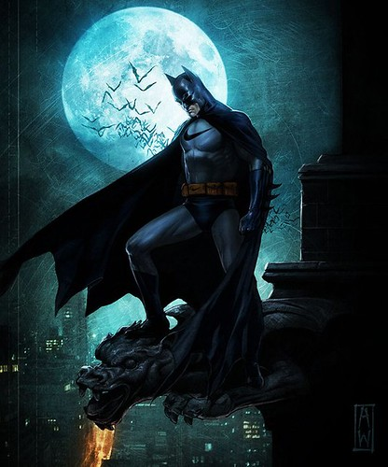
Superheroes – The Shields of Morality and Justice
Superheroes embody justice and inspire us to stand for what is right, showing that anyone can make a difference.
Notes:
fdf

Slide 2
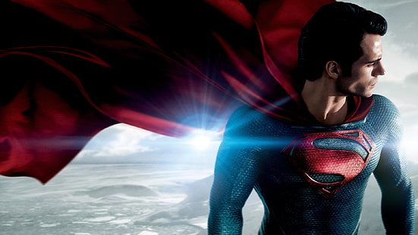
•Superheroes are the guardians of humanity, saving the world from chaos and destruction
Example: Superman stands as a beacon of hope, protecting people against unimaginable threats.
Protecting Society

Slide 3
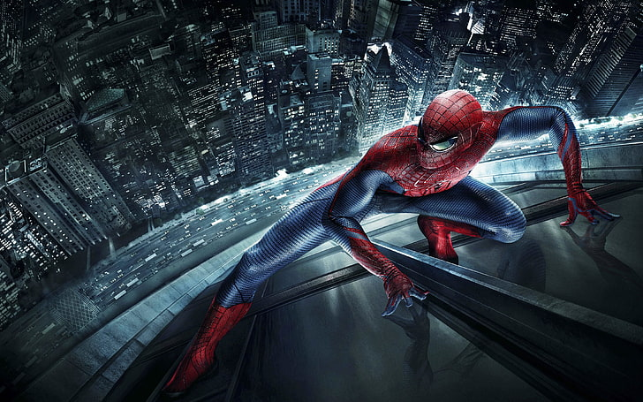
Define Morality
•They teach us values like responsibility and courage.
•Superheroes remind us of the best parts of humanity
Example: Spider-Man’s motto, With great power comes great reponsibility,inspires millions to act selflessly.

